Slide 1

Chapter 5.1
Discrete-Time Markov Chain
Performance Evaluation of the Internet of Things (IoT)
Module Course: Performance Evaluation of Distributed Systems
Prof. Tobias Hoßfeld, Summer Semester 2022

Slide 2
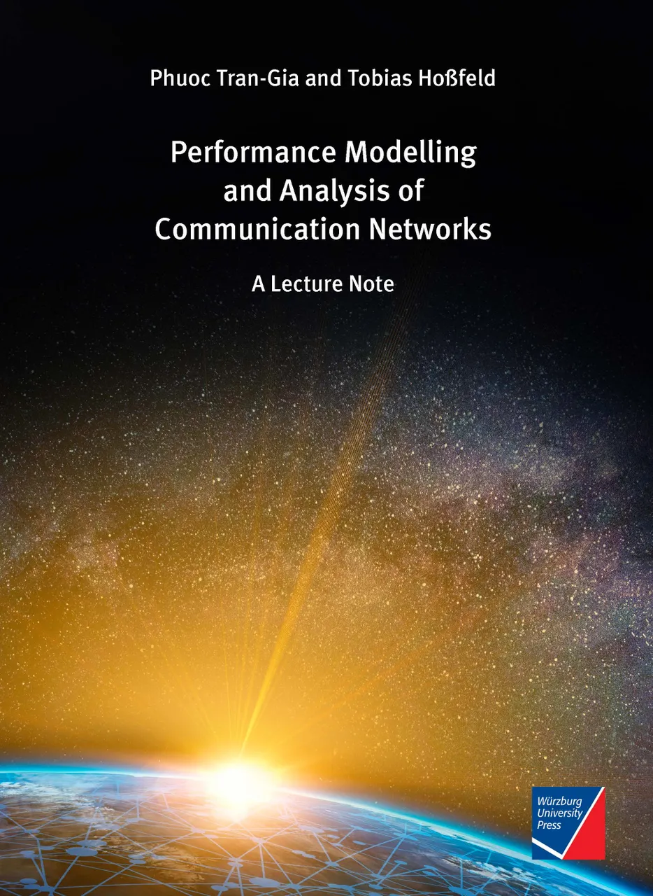
Disclaimer and Copyright Notice
Lecture slides, figures, and scripts are based on the open access text book “Performance Modeling and Analysis of Communication Networks”. The book and scripts are licensed under the Creative Commons License Attribution-ShareAlike 4.0 International (CC BY-SA 4.0). If you remix, transform, or build upon the material, you must distribute your contributions under the same license as the original.
The book must be cited and the disclaimer attached when using lectures slides or scripts.
Tran-Gia, P. & Hossfeld, T. (2021). Performance Modeling and Analysis of Communication Networks - A Lecture Note. Würzburg University Press. https://doi.org/10.25972/WUP-978-3-95826-153-2
Website to download book, exercises, slides and scripts: https://modeling.systems/

Slide 3
Chapter 5
5 Analysis of Non-Markovian Systems
5.1 Discrete-Time Markov Chain
5.2 Method of Embedded Markov Chain
5.2.1 Power Method for Numerical Derivation
5.2.2 Notion of Embedding Times
5.2.3 Kleinrock’s Result
5.3 Delay System M/GI/1
5.3.1 Model Structure and Parameters
5.3.2 Markov Chain and State Transition
5.3.3 State Equation
5.3.4 State Probabilities
5.3.5 Delay Distribution
5.3.6 Other System Characteristics
5.3.7 State Probabilities at Arbitrary Time
5.4 Delay System GI/M/1
5.4.1 Model Structure and Parameters
5.4.2 Markov Chain and State Transition
5.4.3 State Probabilities
5.4.4 State Analysis with Geometric Approach
5.4.5 Waiting Time Distribution
5.5 Model with Batch Service and Threshold Control
5.5.1 Model Structure and Parameters
5.5.2 Markov Chain and State Transition
5.5.3 State Probabilities and System Characteristics
5.6 Results for Continuous-Time GI/GI/1 Delay Systems
5.6.1 Characteristics of GI/GI/1 Delay Systems
5.6.2 Lindley Integral Eq. GI/GI/1 Systems
5.6.3 Kingman’s Approximation of Mean Waiting Times

Slide 4
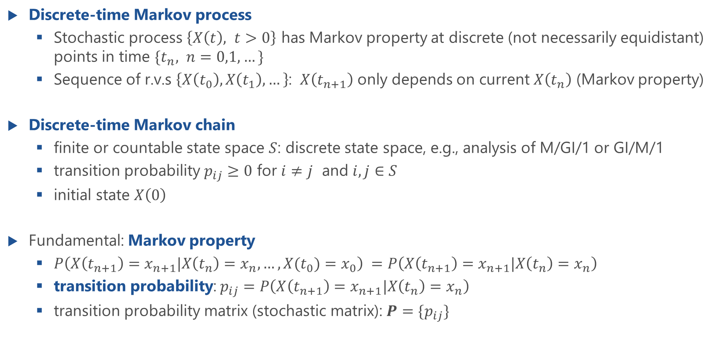
Discrete-Time Markov Chain (DTMC)
Discrete-time Markov process
Stochastic process $\left\{X\left(t\right), t>0\right\}$ has Markov property at discrete (not necessarily equidistant) points in time ${\{t}_{n}, n=0,1,…\}$
Sequence of r.v.s $\left\{X\left(t_{0}\right), X\left(t_{1}\right), …\right\}$: $X\left(t_{n+1}\right)$ only depends on current $X\left(t_{n}\right)$ (Markov property)
Discrete-time Markov chain
finite or countable state space $S$: discrete state space, e.g., analysis of M/GI/1 or GI/M/1
transition probability $p_{ij}≥0$ for $i≠j$ and $i,j∈S$
initial state $X\left(0\right)$
Fundamental: Markov property
$P\left(X\left(t_{n+1}\right)=x_{n+1}|X\left(t_{n}\right)=x_{n},…,X(t_{0})=x_{0}\right) =P\left(X\left(t_{n+1}\right)=x_{n+1}|X\left(t_{n}\right)=x_{n}\right)$
transition probability: $p_{ij}=P\left(X\left(t_{n+1}\right)=x_{n+1}|X\left(t_{n}\right)=x_{n}\right)$
transition probability matrix (stochastic matrix): $P=\{p_{ij}\}$

Slide 5
Continuous-Time Markov Chain (CTMC)
Continuous-time Markov process
Stochastic process $\left\{X\left(t\right),t≥0\right\}$ with Markov property
Continuous-time Markov chain (CMTC) is defined by
discrete state space $S$ is finite or countable; e.g. number of customers in system
transition rates $q_{ij}≥0$ for $i≠j$ and $i,j∈S$
initial state $X(0)$, i.e. probability distribution of initial state
Probability $x\left(i,t\right)=P\left(X\left(t\right)=i\right)$ that the system is in state $\left[X=i\right]$ at time $t$
State vector $X\left(t\right)=\left(x\left(t,0\right),x\left(t,1\right),…\right)$
Definition of rate matrix $Q$ with $q_{ii}=−\sum_{i≠j}{q_{ij}}$
allows compact notation (Kolmogorov equations.)
row-wise sums of $Q$ are 0

Slide 6
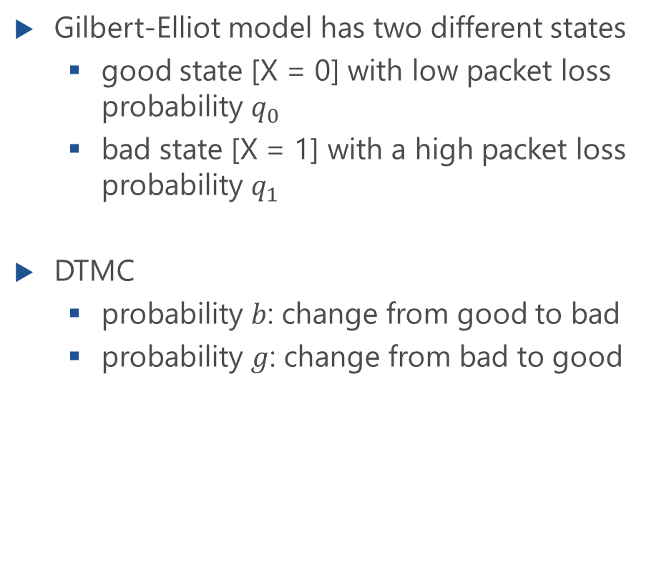
Example: Bursty Channel (Gilbert-Elliot Model)
Gilbert-Elliot model has two different states
good state [X = 0] with low packet loss probability $q_{0}$
bad state [X = 1] with a high packet loss probability $q_{1}$
DTMC
probability $b$: change from good to bad
probability $g$: change from bad to good
Transition diagram with transition probabilities
Transition matrix

Slide 7
DTMC of a CTMC

Slide 8
Chapter 5.2
Method of Embedded Markov Chain
Performance Evaluation of the Internet of Things (IoT)
Module Course: Performance Evaluation of Distributed Systems
Prof. Tobias Hoßfeld, Summer Semester 2022

Slide 9
Regeneration Points of the Embedded Markov Chain

Slide 10
Method of Embedded Markov Chain
State probabilities at embedding times
Transition probability matrix
p
ij
j
i
p
i1
2
2
1
p
i0
1
0
0
t
n
t
n+1

Slide 11
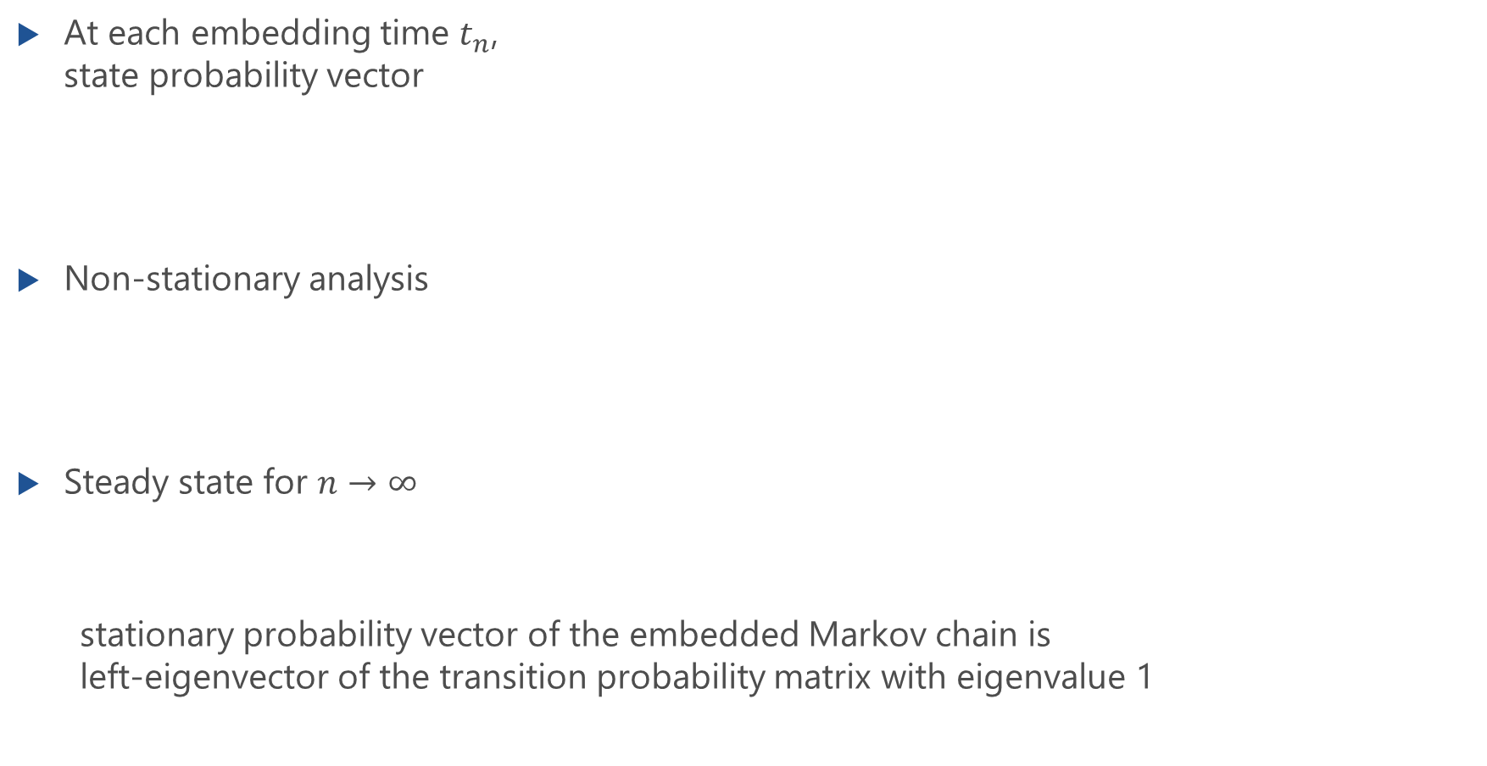
Method of Embedded Markov Chain: Matrix Form
At each embedding time $t_{n}$, state probability vector
Non-stationary analysis
Steady state for $n→∞$
stationary probability vector of the embedded Markov chain is left-eigenvector of the transition probability matrix with eigenvalue 1

Slide 12
Power Method
Numerical solution

Slide 13
Power Method
Numerical robust method for non-stationary analysis of embedded Markov chains
An implementation of the power method is provided at https://modeling.systems

Slide 14
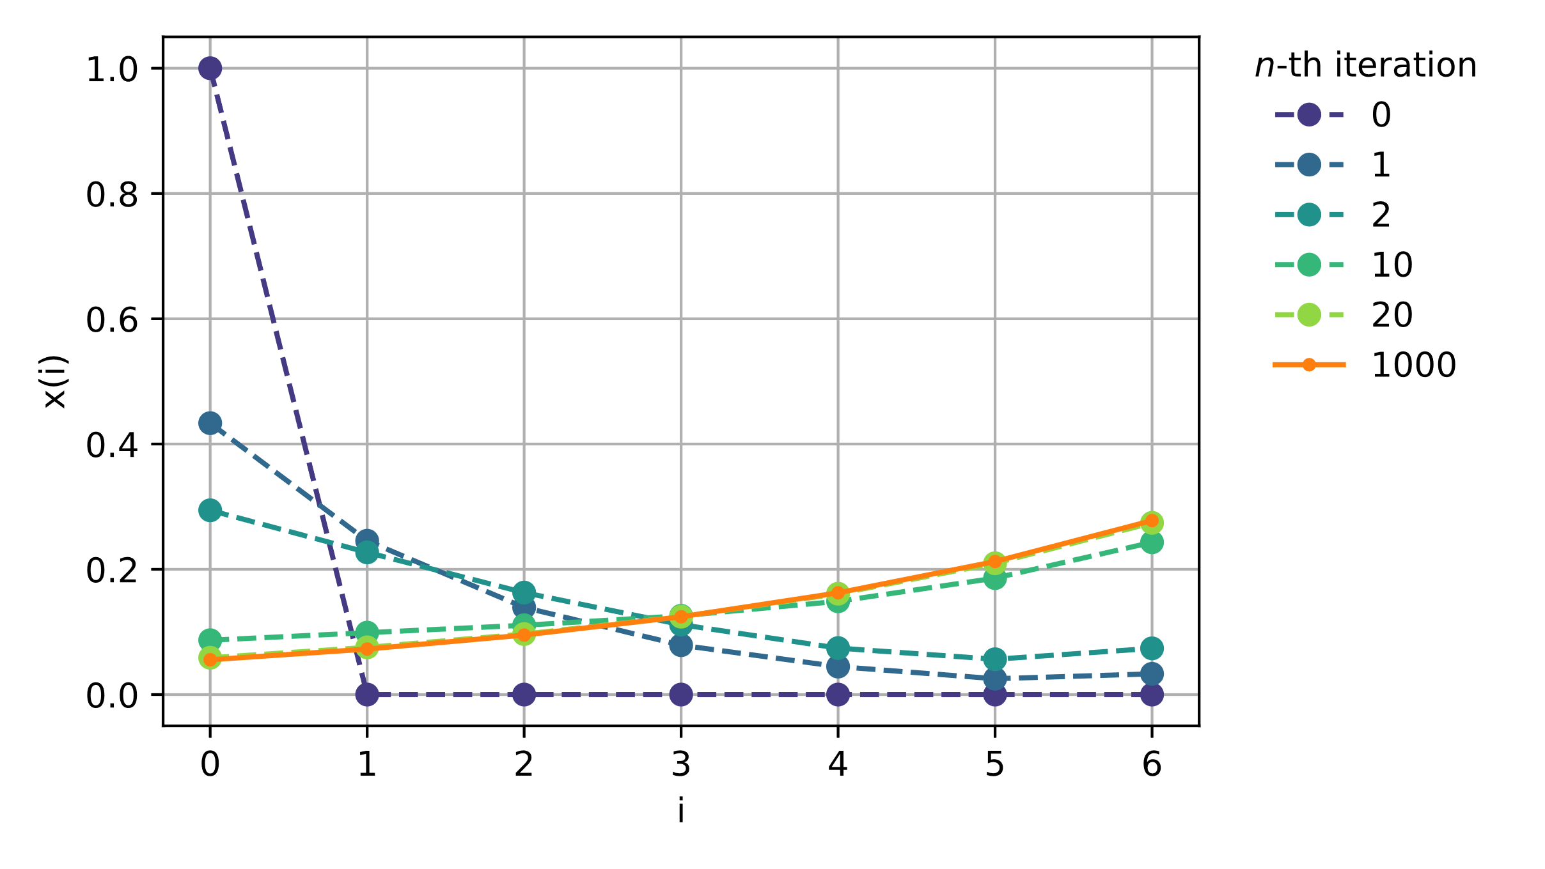
Illustration of Power Method
Analysis of M/GI/1-5 quickly converges

Slide 15
Notion of Embedding Times
Kleinrock’s (Burke’s) result

Slide 16
Notion of Embedding Times

Slide 17
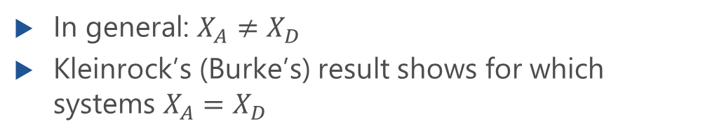
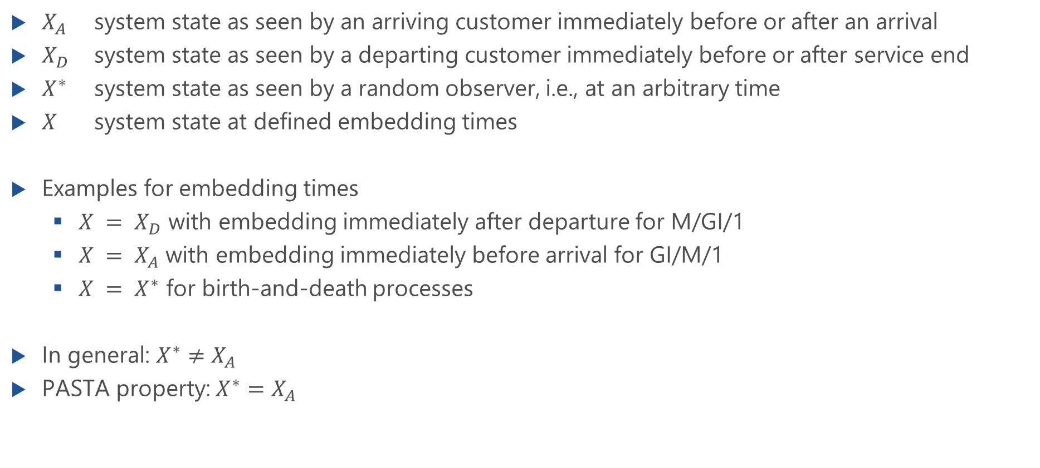
Variables of System State at Embedding Times
$X_{A}$ system state as seen by an arriving customer immediately before or after an arrival
$X_{D}$ system state as seen by a departing customer immediately before or after service end
$X^{∗}$ system state as seen by a random observer, i.e., at an arbitrary time
$X$ system state at defined embedding times
Examples for embedding times
$X = X_{D}$ with embedding immediately after departure for M/GI/1
$X = X_{A}$ with embedding immediately before arrival for GI/M/1
$X = X^{∗}$ for birth-and-death processes
In general: $X^{∗}≠X_{A}$
PASTA property: $X^{∗}=X_{A}$
In general: $X_{A}≠X_{D}$
Kleinrock’s (Burke’s) result shows for which systems $X_{A}=X_{D}$

Slide 18
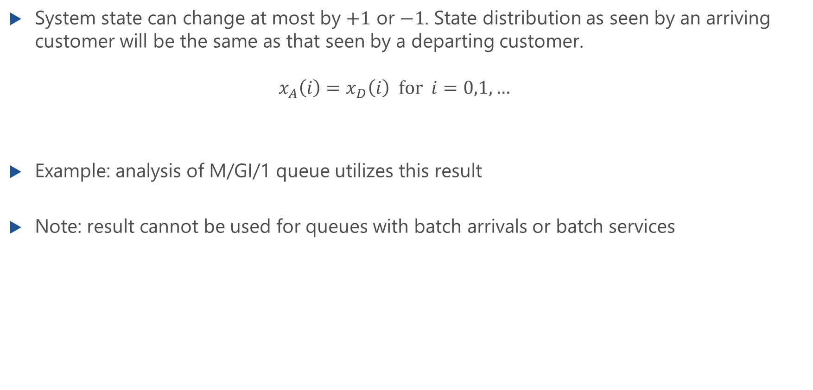
Kleinrock’s (Burke’s) Result
System state can change at most by $+1$ or $−1$. State distribution as seen by an arriving customer will be the same as that seen by a departing customer. $x_{A}\left(i\right)=x_{D}\left(i\right) for i=0,1,…$
Example: analysis of M/GI/1 queue utilizes this result
Note: result cannot be used for queues with batch arrivals or batch services

Slide 19
Kleinrock’s (Burke’s) Result: Derivation
Lecture

